Slide 1
Pretraining with Dictionaries

Slide 2
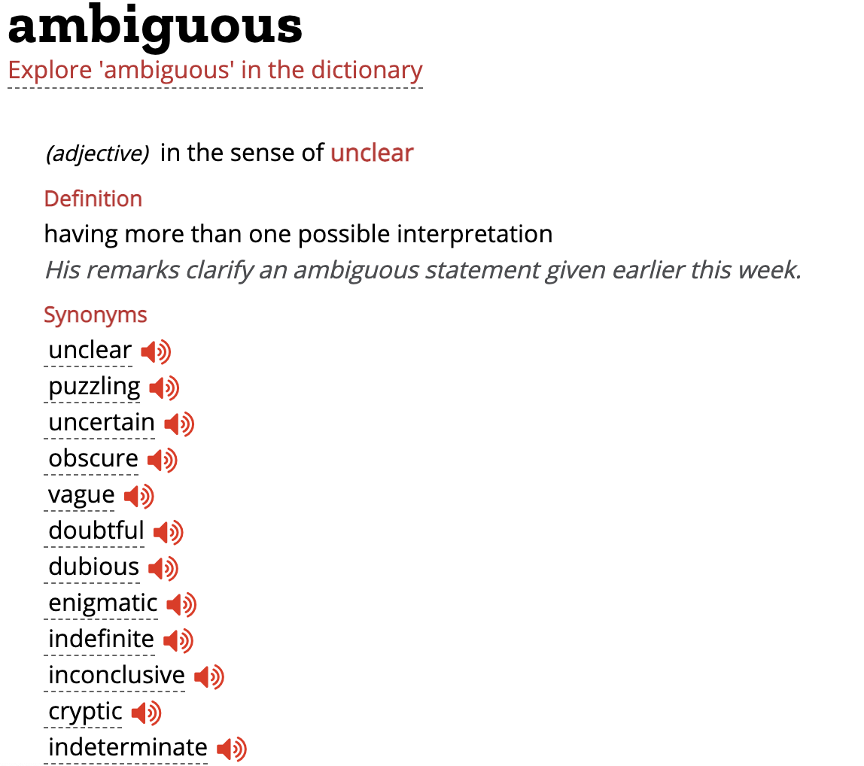
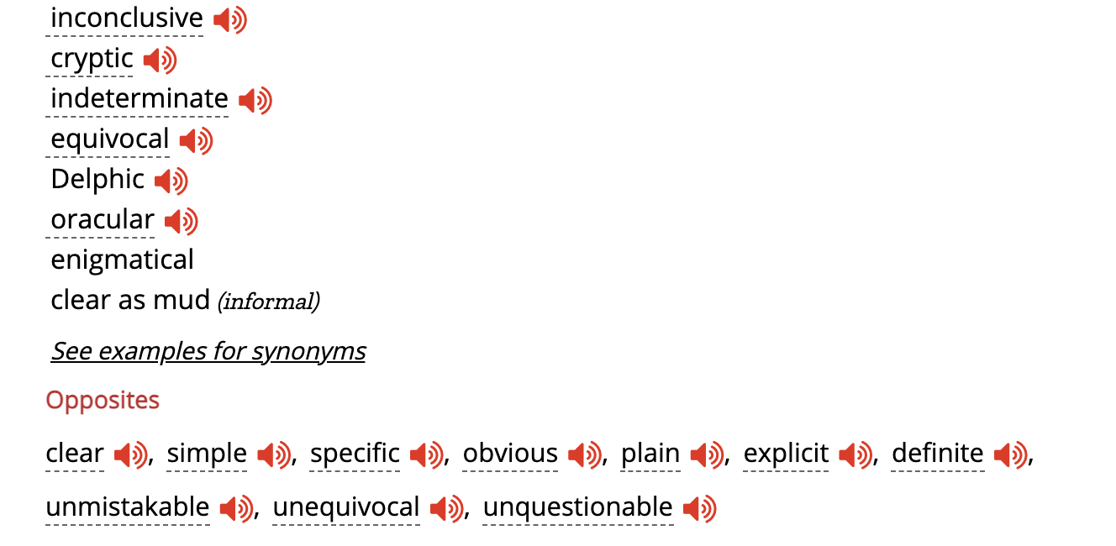
Motivation
Vocabulary is the basic element of a language. For a new language learner, he/she starts with memorizing elementary vocabularies and then applies to more complicated tasks.
Dictionary provides a weakly supervised dataset for all vocabularies with definition and synonym & antonym as weak labels. With the “labelled” data, pretraining is assumed to be much more efficient than MLM only.

Slide 3
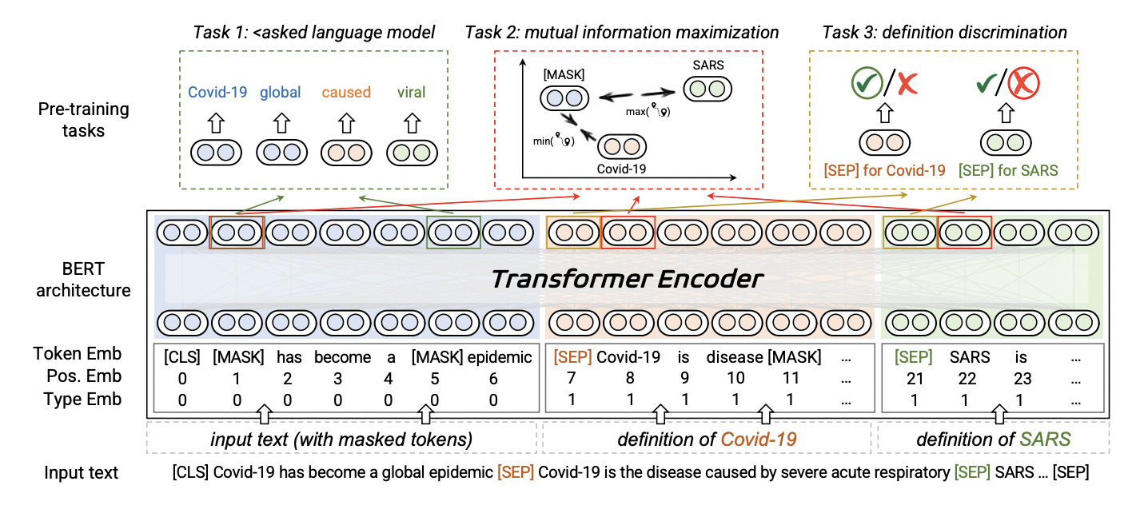
Related Work
A related work is Dict-BERT, which utilizes word Definition for solving rare word problem.
It directly pads defition to raw input sentence while pretraining.

Slide 4
Pretraining Design ( a possible version )
With labelled data, Contrastive Learning task can be introduced for pretraining, which performs more efficiently than MLM.
For Antonym/Synonym: Contrastive Learning
It could work as an entailment task, with antonyms being “contradiction”, synonyms ( and self ) being “entailment” and randomly sampled words being “neutral”.
For Definition: Sentence Embedding + Contrastive Learning
Similar to below, with sentence embedding replacing the central word.
For Example Sentences: MLM/LM
Note this fashion can also be adapted for multilingual models, just using multilingual dictionaries.

Slide 5
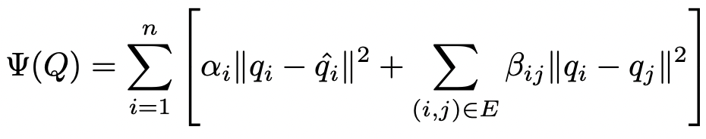
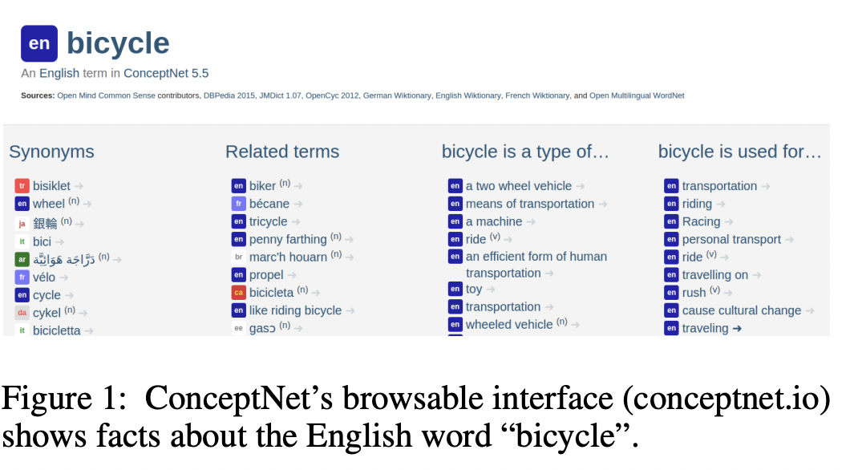
Pretraining Design ( a possible version )
A similar idea is ConceptNet, which integrate a common-sense Knowledge Graph to pretrained models using retrofitting method through encouraging word embeddings to be close to their original values as well as their neighbors in graph:
While the motivation is different: pretraining with dicts aims at pretraining efficiency, and we assume the additional info incorporated in dicts can also be fully learned with MLM ( with lower efficiency ). And the computational cost for adding dicts is much smaller so that it can adapted to any pretraining model.

Slide 6
Possible Problems
Limited data in dictionaries
It can be mitigated by collecting as many dictionaries as possible. On the other side, we assert that using dictionary data could be more efficient, thus we do not require comparable amount of data as Wiki.
Long sequence modeling
This can be a real bottleneck for pretraining on dictionaries, since example sentences are usually short. A possible solution is to combine dictionaries as weakly supervised data and Wiki as unlabelled data to pretrain together.

